Slide 1
Graphs
Connecting Data
Programming – Code Design and Data Structures

Slide 2
Contents
What is a graph
Connecting Data
Nodes and Edges
Different Graph Types
Properties of Graphs
Storing Graphs
Inserting and removing from a graph

Slide 3
What is a Graph
A graph is a data structure for storing the relationships between data points
In other words, how each piece of data is connected
There are two main parts of a graph
Vertices
These are the data points
Edges
These are the relationships / connections

Slide 4
Connecting Data
Graph | Vertex | Edge
Communication | Telephones, Computers, Exchanges | Copper / Fiber-Optic cables
Transportation | Houses, Intersections, Airports, Docks | Roads, flight paths, shipping lanes
Facebook | People, Pages, Events | Friendships, Likes
World Wide Web | Web Pages | Hyperlinks
File System | Files | Folders, Shortcuts
Chess | Board Positions | Legal Moves

Slide 5
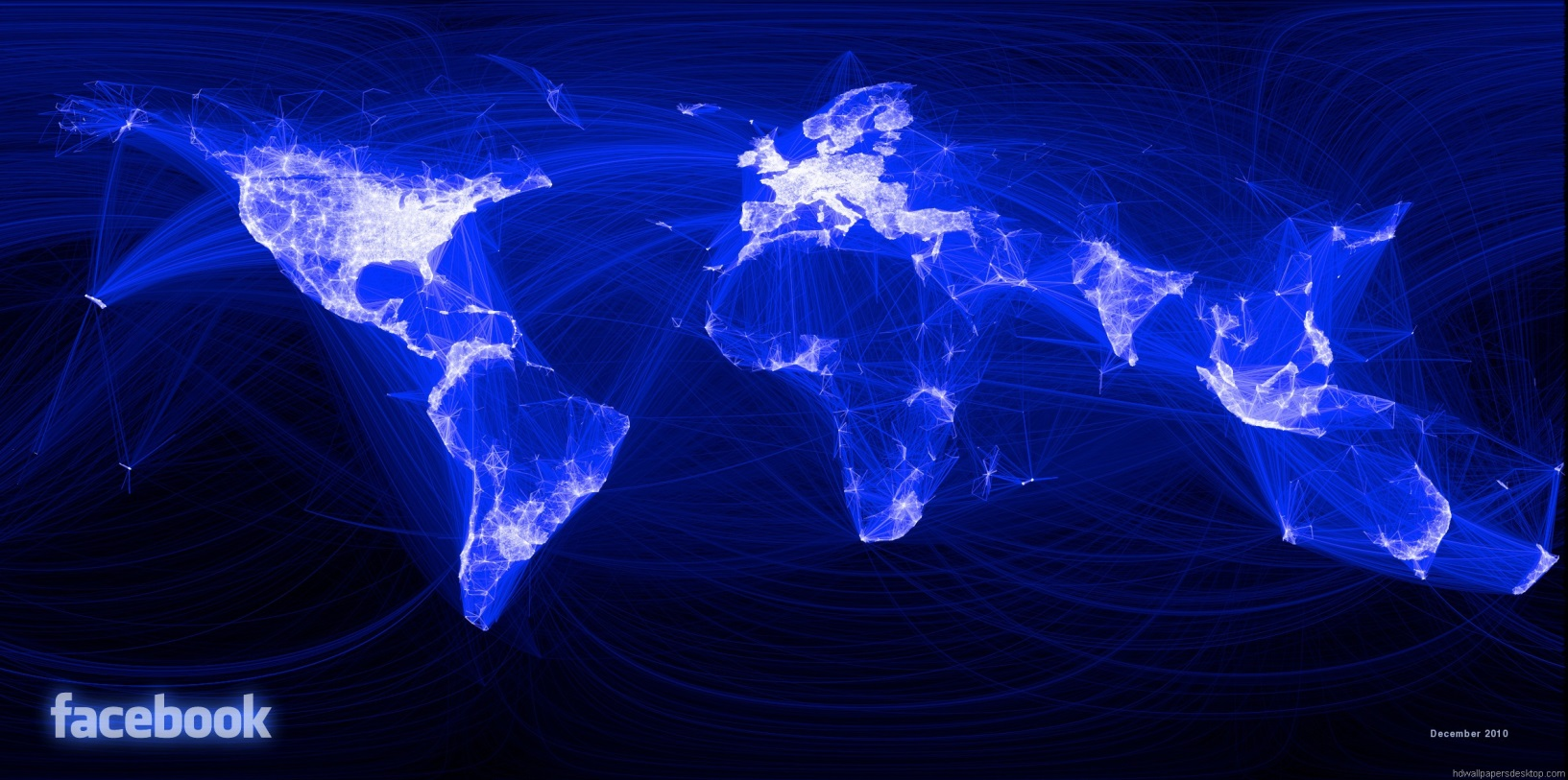
Connecting Data
Notes:
This is a visual image of all the friend connections on facebook

Slide 6
Nodes and Edges
The vertices of a graph can also be called Nodes
All a node has inside of it is some piece of data, dependant on the graph, and a list of edges
Edges are sometimes stored externally
Edges contain either contain
Two Nodes that connect together, for a two-way link
One Node that the Edge leads to, for a one-way link
They also typically include information about the relationship between the Nodes

Slide 7
Types of Graphs
Defined by what kind of edges the graph has
Edges can be one-way or two-way
Typically called directed or undirected
For example, friends of Facebook are undirected, followers of twitter are directed

Slide 8
Types of Graphs
A graph that only has undirected edges is a non-directed graph
If a graph has directed edges then it is a directed graph, or digraph
If the digraph has a cycle, then it is a cyclic graph
A cycle is a path of at least 3 nodes that starts and ends on the same node
If the digraph has no cycles it is an acyclic graph

Slide 9
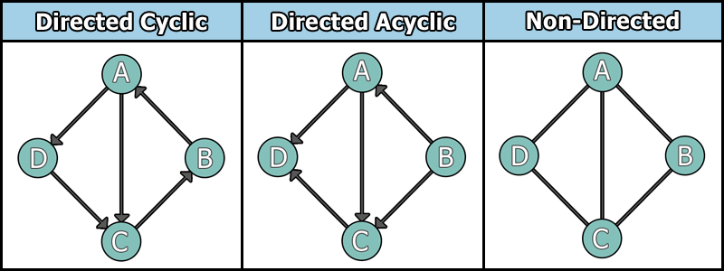
Types of Graphs

Slide 10
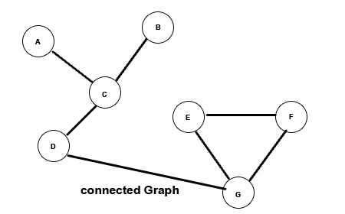
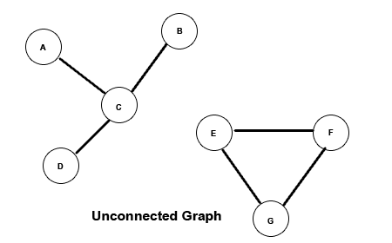
Other Properties of Graphs
A connected graph is a graph where, if you ignore directions, you can get from any node to any other node
The opposite of a connected graph is an unconnected or disjoint graph

Slide 11
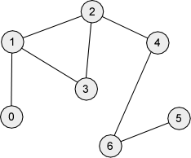
Other Properties of Graphs
The degree of a vertex is how many connections it has
In the following example, Node 5 has a degree of 1
Node 1 has a degree of 3

Slide 12
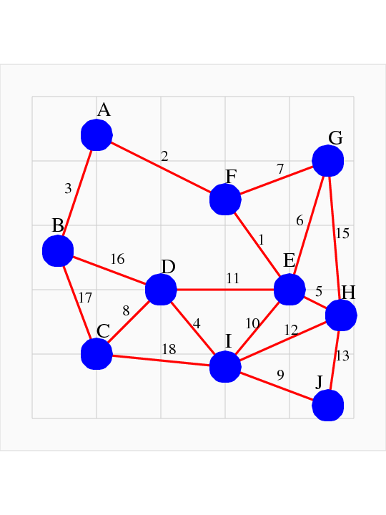
Other Properties of Graphs
A weighted graph is one where each edge has a cost associated with it
The connections on a social network are typically non-weighted
However, the links for graph of a map, where the nodes are places and the edges are roads, might have each edge weight be the length of the road

Slide 13
How to Store Graphs
There are two main ways to store graphs in a computer
An Adjacency Matrix
An Adjacency List

Slide 14
Adjacency Matrix
You use an array to store the nodes and a matrix to store the edges
The array is just a list of each node
The matrix is a square 2-dimensional array of connections between different nodes
The size is equal to the number of nodes in the graph
Notes:
The array is just the list of verts, it doesn’t have to be ordered

Slide 15
Adjacency Matrix
In the matrix, the row represents the starting node, and the column represents the ending node
The data stored at that index of the matrix contains information about the link
The minimum information would be if the link exists or not, but could also include the cost or any other information the graph needs

Slide 16
Adjacency Matrix
0
1
Array:
0 | 1 | 2 | 3 | 4 | 5
Matrix:
- | 0 | 1 | 2 | 3 | 4 | 5
0 | 0 | 1 | 0 | 0 | 0 | 1
1 | 0 | 0 | 1 | 0 | 0 | 0
2 | 1 | 0 | 0 | 1 | 0 | 0
3 | 0 | 0 | 0 | 0 | 1 | 0
4 | 0 | 0 | 0 | 0 | 0 | 0
5 | 0 | 0 | 0 | 1 | 1 | 0
2
5
3
4

Slide 17
Adjacency Matrix
Pros:
Really fast to check if two nodes are connected
Cache friendly
Some algorithms are easier to implement
Cons
Costly to add or remove nodes
Can’t have more than one link between nodes
Wastes memory as you still need slots for edges that don’t exist

Slide 18
Adjacency List
The other way to store a graph is an adjacency list
Each node simply contains a list of edges to the nodes they are connected to

Slide 19
Adjacency List
0 | 1 | 2 | 3 | 4 | 5
0
1
3 | 4
2
4
5
3
0 | 3
4
2
1 | 5

Slide 20
Adjacency List
Pros:
More Flexible
Uses less memory
Cons:
Slower to find edges

Slide 21
Graph Operations
We will now describe methods for some common operations you might want to perform on a graph
For the rest of these slides it is assumed we are using a directed graph with adjacency lists

Slide 22
Graph Operations – Creating a Graph
Our Graph object simply contains an array of the nodes within it
Node Objects
A Node Object contains our node data and an array of Edge Objects that connect the node to other nodes
Our Edge Object contains two Node pointers – its start and end nodes, and an integer for the cost of traversing the edge

Slide 23
Graph Operations – Inserting a Node
Inserting a node into our graph is simple
We can define that nodes inserted in our graph will begin disjoint to the rest of the graph
This means, all we need to do is create a new node and insert it into the node list in our graph object

Slide 24
Graph Operations – Inserting a Node
0 | 1 | 2 | 3 | 4 | 5
0
1
3 | 4
2
4
5
3
0 | 3
4
2
1 | 5

Slide 25
Graph Operations – Inserting a Node
0 | 1 | 2 | 3 | 4 | 5 | 6
0
1
3 | 4
2
4
5
3
0 | 3
4
6
2
1 | 5

Slide 26
Graph Operations – Inserting an Edge
Given two nodes, N1 and N2, inserting an edge from N1 to N2 also quite simple
We first create a new edge
Then, we set its start and end pointers to point at N1 and N2 respectively
We then add the edge to N1’s edge list

Slide 27
Graph Operations – Inserting an Edge
0 | 1 | 2 | 3 | 4 | 5 | 6
0
1
3 | 4
2
4
5
3
0 | 3
4
6
2
1 | 5

Slide 28
Graph Operations – Inserting an Edge
0 | 1 | 2 | 3 | 4 | 5 | 6
0
1
3 | 4
2
4
5
3
0 | 3
4
6
2
1 | 5

Slide 29
Graph Operations – Inserting an Edge
0 | 1 | 2 | 3 | 4 | 5 | 6
0
1
3 | 4
2
4
5
3
0 | 3
4
6
2
1 | 5

Slide 30
Graph Operations – Inserting an Edge
0 | 1 | 2 | 3 | 4 | 5 | 6
0
1
3
3 | 4
2
4
5
3
0 | 3
4
6
2
1 | 5

Slide 31
Graph Operations – Inserting an Edge
0 | 1 | 2 | 3 | 4 | 5 | 6
0
1
3
3 | 4
2
4
5
3
0 | 3
4
6
2
1 | 5

Slide 32
Graph Operations – Removing an Edge
To remove an edge going from node N1 to node N2
We first loop through the edge list in N1, checking each edge’s end pointer, checking if it is equal to N2
Once we find the correct edge, we simply remove it from the edge list of the node

Slide 33
Graph Operations – Removing a Node
Removing a node is slightly more complicated as we need to ensure that all edges pointing to that node are first removed
We first loop through all the nodes on our Graph
For each node we loop through all of its edges
For each edge, we check if it’s end is equal to the node we want to remove
If it is we remove it from the edge list for that node
Once we’ve looped through all the nodes in the graph we can remove the desired node from the node list

Slide 34
Graph Operations – Removing Node 4
0 | 1 | 2 | 3 | 4 | 5 | 6
0
1
3
3 | 4
2
4
5
3
0 | 3
4
6
2
1 | 5

Slide 35
Graph Operations – Removing Node 4
0 | 1 | 2 | 3 | 4 | 5 | 6
0
1
3
3 | 4
2
4
5
3
0 | 3
4
6
2
1 | 5

Slide 36
Graph Operations – Removing Node 4
0 | 1 | 2 | 3 | 4 | 5 | 6
0
1
3
3 | 4
2
4
5
3
0 | 3
4
6
2
1 | 5

Slide 37
Graph Operations – Removing Node 4
0 | 1 | 2 | 3 | 4 | 5 | 6
0
1
3
3 | 4
2
4
5
3
0 | 3
4
6
2
1 | 5

Slide 38
Graph Operations – Removing Node 4
0 | 1 | 2 | 3 | 4 | 5 | 6
0
1
3
3 | 4
2
4
5
3
0 | 3
4
6
2
1 | 5

Slide 39
Graph Operations – Removing Node 4
0 | 1 | 2 | 3 | 4 | 5 | 6
0
1
3
3 | 4
2
4
5
3
0 | 3
4
6
2
1 | 5

Slide 40
Graph Operations – Removing Node 4
0 | 1 | 2 | 3 | 4 | 5 | 6
0
1
3
3 | 4
2
4
5
3
0 | 3
4
6
2
1 | 5

Slide 41
Graph Operations – Removing Node 4
0 | 1 | 2 | 3 | 4 | 5 | 6
0
1
3
3 | 4
2
5
3
0 | 3
4
6
2
1 | 5

Slide 42
Graph Operations – Removing Node 4
0 | 1 | 2 | 3 | 4 | 5 | 6
0
1
3
3 | 4
2
5
3
0 | 3
4
6
2
1 | 5

Slide 43
Graph Operations – Removing Node 4
0 | 1 | 2 | 3 | 4 | 5 | 6
0
1
3
3 | 4
2
5
3
0 | 3
4
6
2
1 | 5

Slide 44
Graph Operations – Removing Node 4
0 | 1 | 2 | 3 | 4 | 5 | 6
0
1
3
3 | 4
2
5
3
0 | 3
4
6
2
1 | 5

Slide 45
Graph Operations – Removing Node 4
0 | 1 | 2 | 3 | 4 | 5 | 6
0
1
3
3 | 4
2
5
3
0 | 3
4
6
2
1 | 5

Slide 46
Graph Operations – Removing Node 4
0 | 1 | 2 | 3 | 4 | 5 | 6
0
1
3
3
2
5
3
0 | 3
4
6
2
1 | 5

Slide 47
Graph Operations – Removing Node 4
0 | 1 | 2 | 3 | 4 | 5 | 6
0
1
3
3
2
5
3
0 | 3
4
6
2
1 | 5

Slide 48
Graph Operations – Removing Node 4
0 | 1 | 2 | 3 | 5 | 6
0
1
3
3
2
5
3
0 | 3
6
2
1 | 5

Slide 49
Non-Directed Graphs
To change these descriptions to suit a non-directed graph you only need to make a few changes
First, when adding or removing an edge, we need to add or remove it from the edge lists in both N1 and N2
Second, when removing a node, we only need to loop through the edges in the node we want to remove, erasing the edges from each end node

Slide 50
Graphs in Games
Graphs are used all over the place in games
Most commonly in path-finding, and decision making
In pathfinding, nodes represent places you can walk, with edges being the paths between them.
Nodes can be walkable or not walkable,
Edge costs can be just the distance between nodes or include extra costs such as walk speed penalties or danger
In decision making, nodes can be sequences of actions (such as attack or search for cover), and edges can be the transitions between behavioural states
More advanced structures such as decision and behaviour trees exist and we cover them at the end of the topic.
Also used for speeding up and organising rendering
Eg portal systems and scene graphs

Slide 51
Summary
Graphs define a collection of nodes, and relationships between pairs of nodes
The graph type is defined by its edges – directed (one-way) or undirected (two-way)
Weighted graphs associate a cost with each edge
We can use an adjacency list or an adjacency matrix to store a graph

Slide 52
Further Reading
Sherrod, A, 2007, Data Structures and Algorithms for Game Developers, 1st Edition, Charles River Media
Cormen, T, et al, 2009, Introduction to Algorithms, 3rd Edition, MIT Press

